Slide 1


Capstone Project
Author: Ahmed Mahamid
Supervisor: Prof.Zeev Barzily
fithub-fitness.com/en
www.fithub.com
www.fithub.com
01

Slide 2
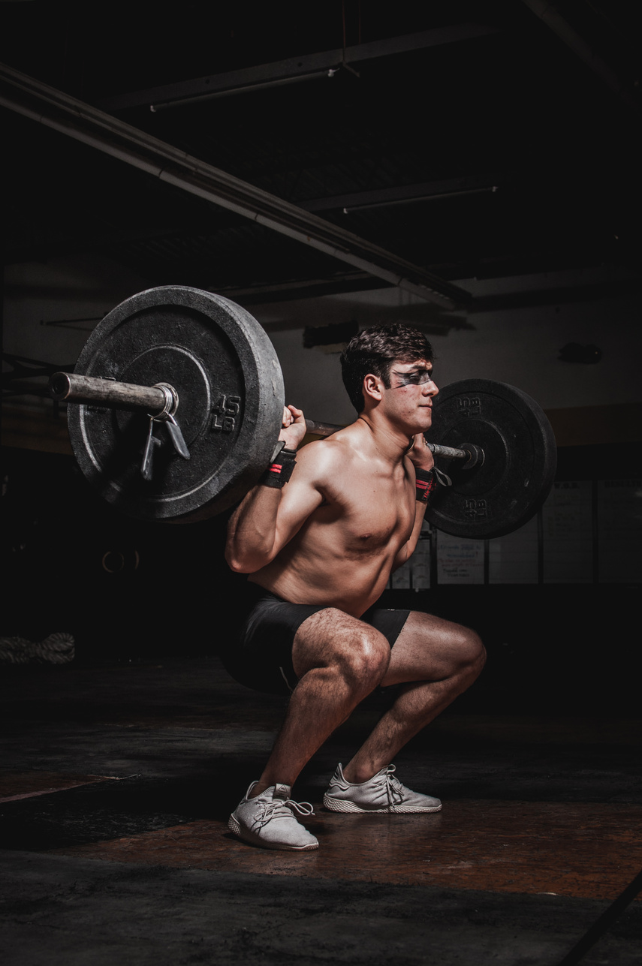
Sport club
FITHUB
www.fithub.com
www.fithub.com
www.fithub.com
02

Slide 3



INTRODUCTION
My sports club management system helps to manage club operations with its user-friendly platform. Members can easily register for courses and manage appointments, while instructors and administrators benefit from streamlined course and instructor management. Enhance your club experience with our all-in-one solution.
04

Slide 4
PROBLEMS
POOR COMMUNICATION WITH MEMBERS
LACK OF MARKETING OPPORTUNITIES:
Difficulty effectively communicating with members, leading to decreased participation and member churn.
Difficulty reaching a new audience and attracting new members.
DATA MANAGEMENT CHALLENGES:
lack of integration between user and admin interfaces
Difficulty tracking member data, such as contact information, payment details.
Existing systems focus on only one interface (administrators or users).
05

Slide 5


Centralized member information to enhance communication and personalization.
Centralized member information to enhance communication and personalization.
SOLUTION
WEBSITE:
CRM MANAGEMENT SYSTEM:
Allow members to view schedules, register for courses, and track their progress .
Push notifications: Send real-time updates about class changes, promotions, and upcoming events.
Easy communication with trainers: Members can message trainers directly through the app, improving engagement and support.
Automate repetitive tasks to save time and resources.
Analyze member behavior data and preferences.
Centralized member information to enhance communication and personalization.
Effective course management, including a schedule and real-time updates.
06

Slide 6
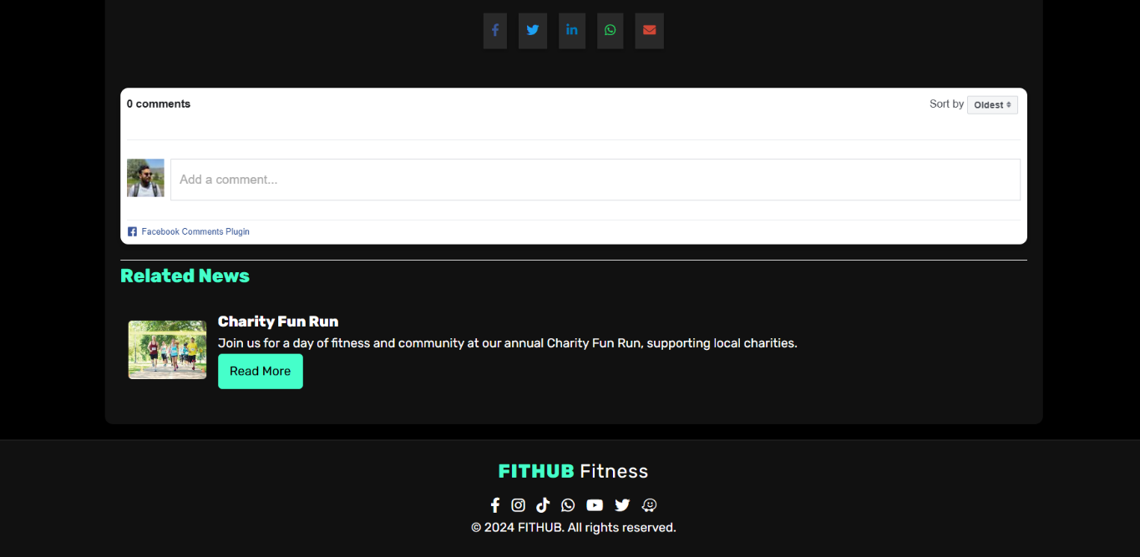
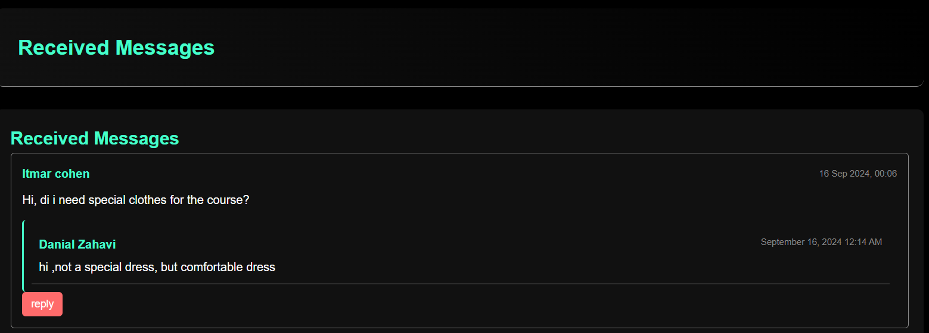
FEATURES
Increasing the club's visibility in search engine results.
Multi-language website and CRM, (Customer Relationship Management)
Dual-Interface System
Facebook comment system.
Mobile-Friendly Design:
Smart platform to handle communications smoothly
07

Slide 7
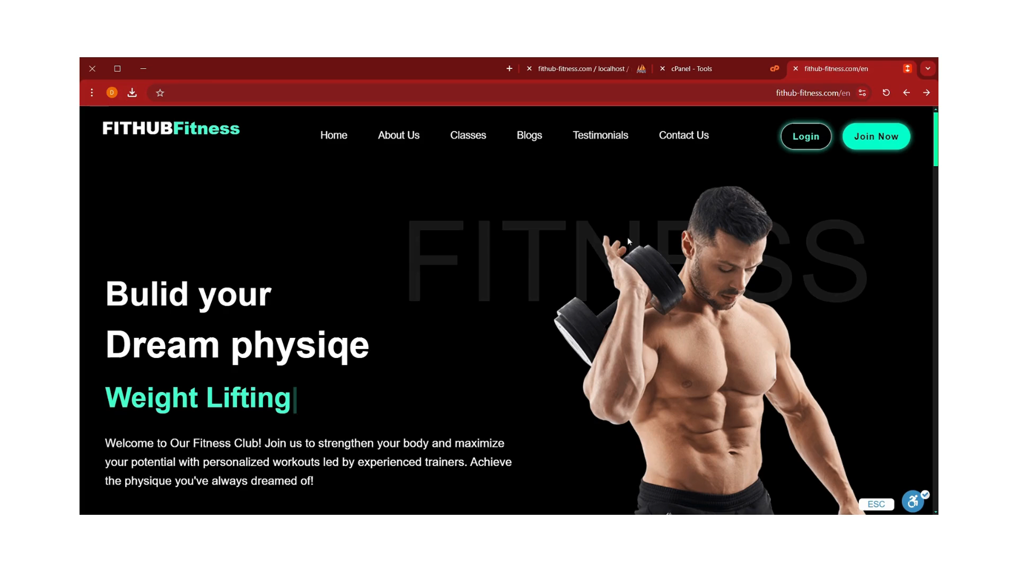
07

Slide 8
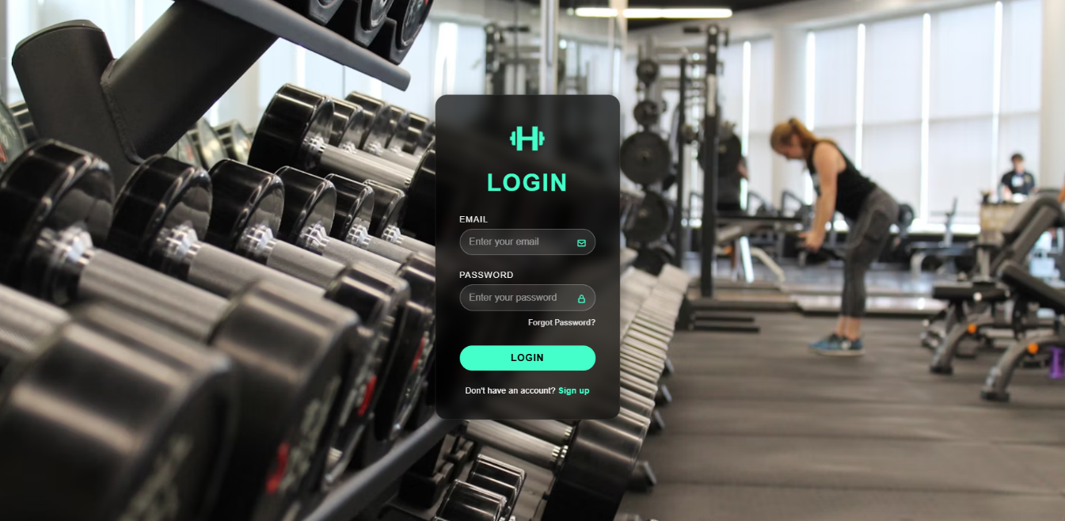
Login
08

Slide 9
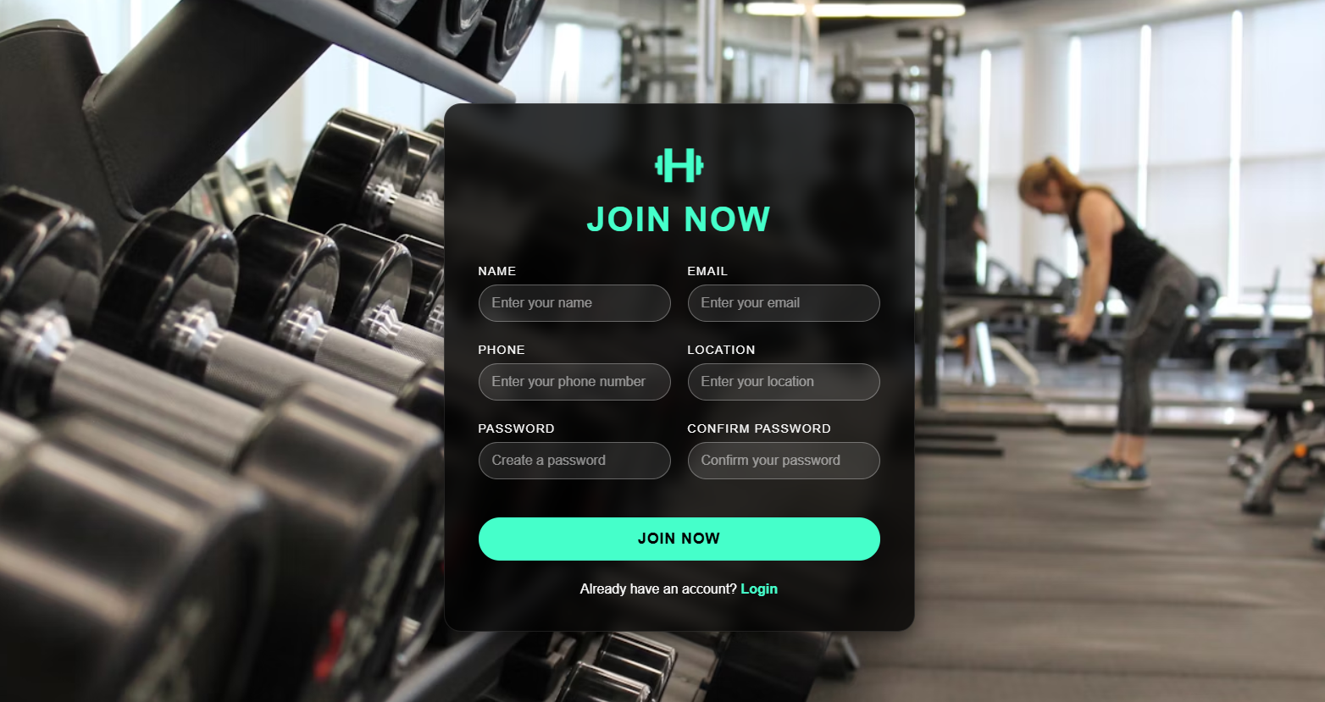
Registration
09

Slide 10
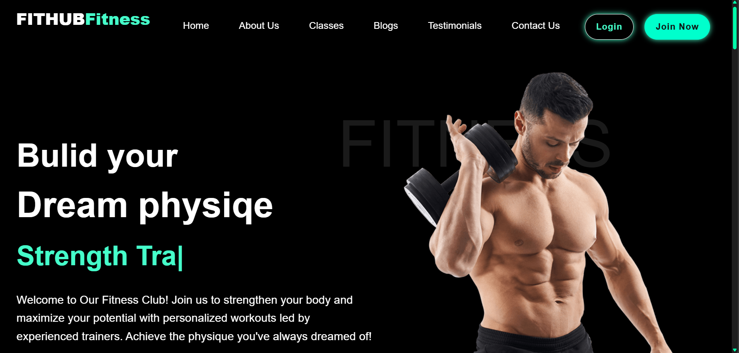
Homepage
10

Slide 11
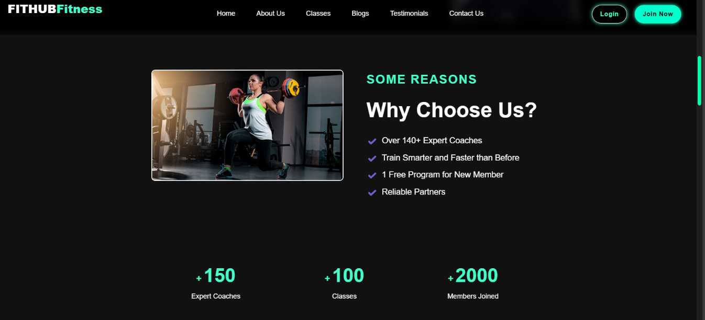
About Us
11

Slide 12
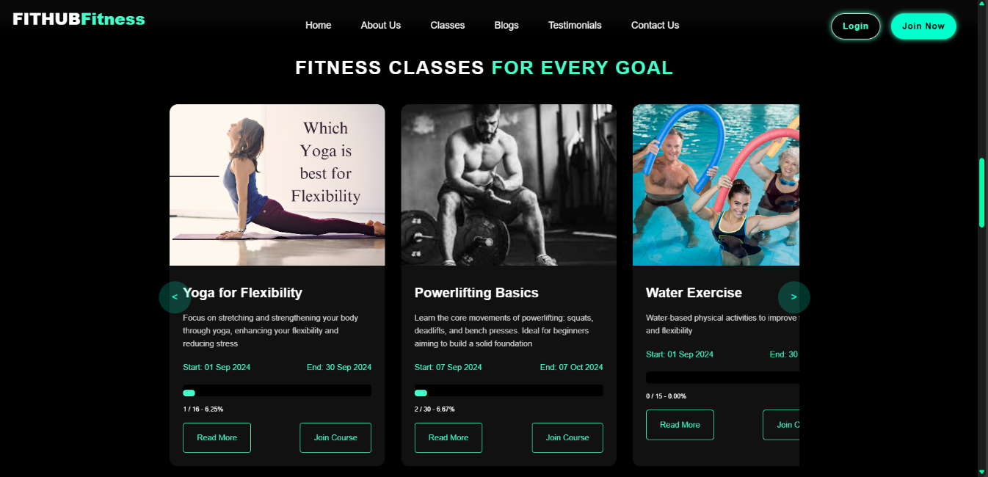
Course Listings
12

Slide 13
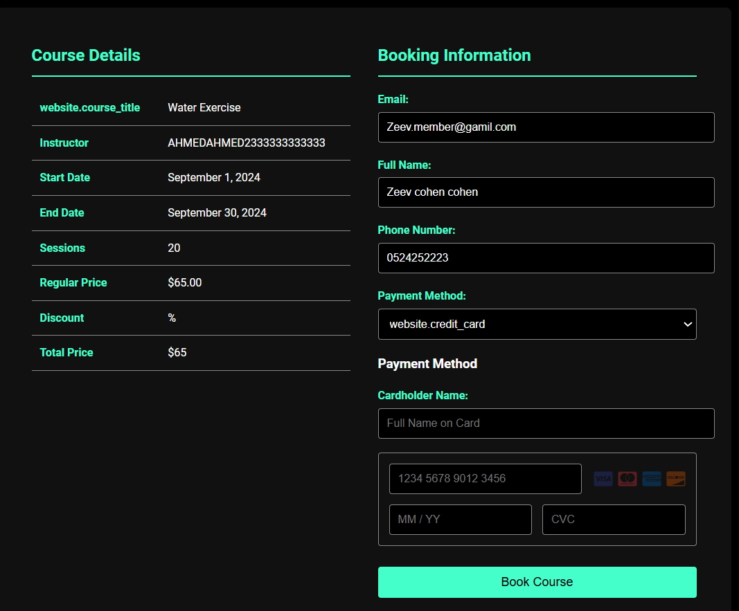
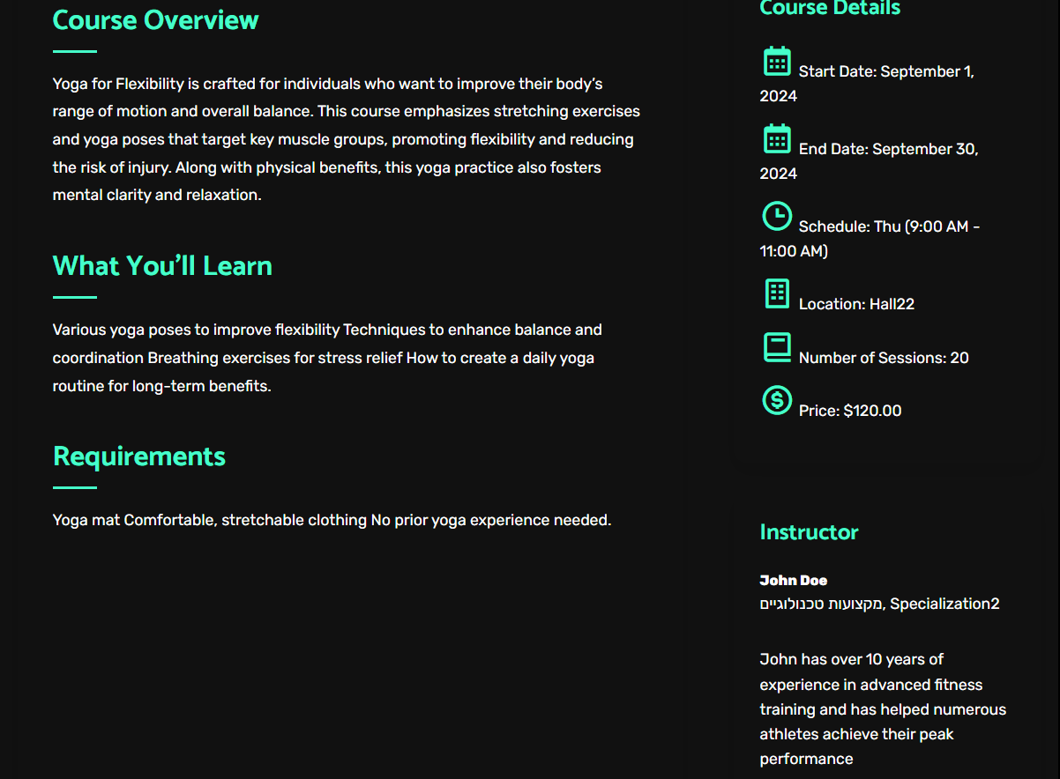
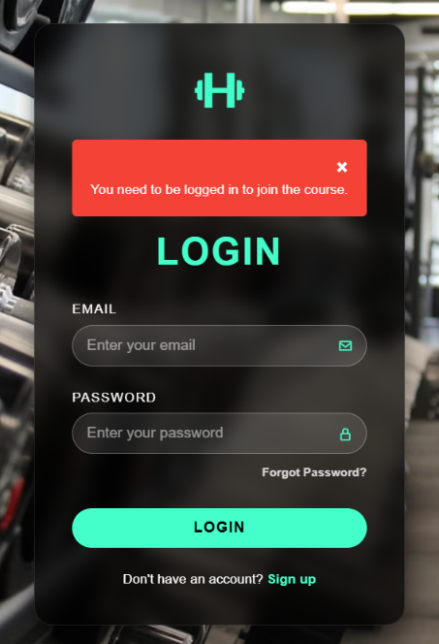
Course Listings
13

Slide 14
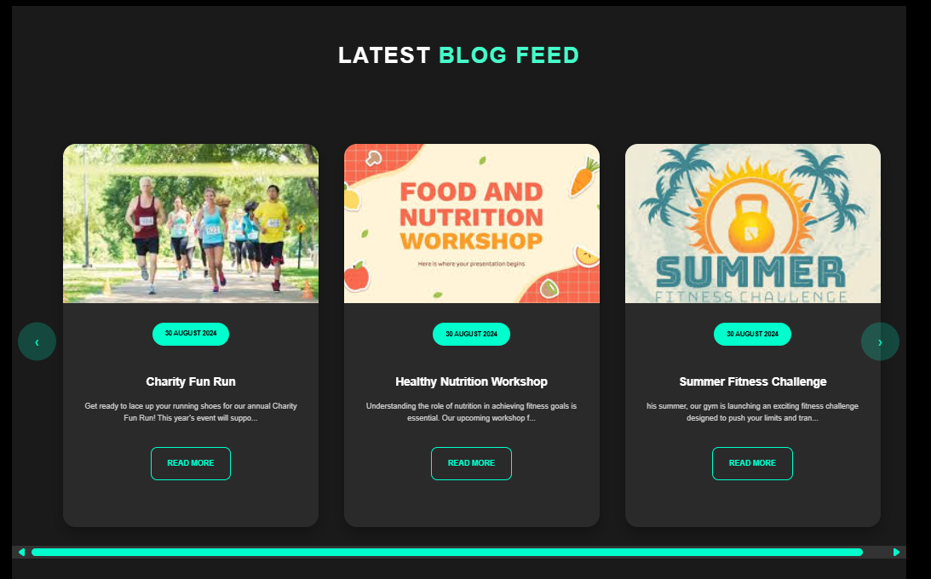

Latest Blog Feed
14

Slide 15
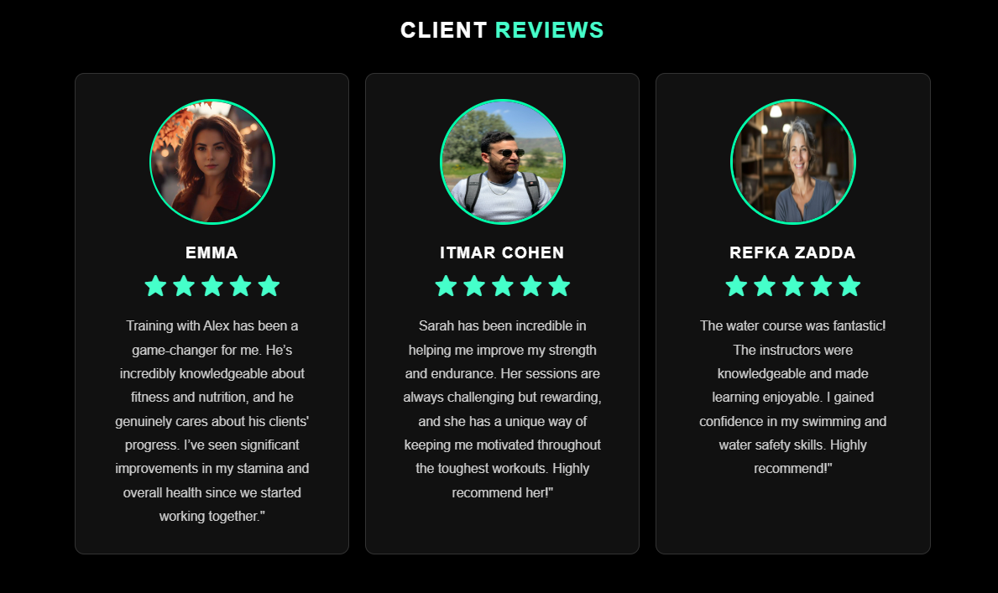
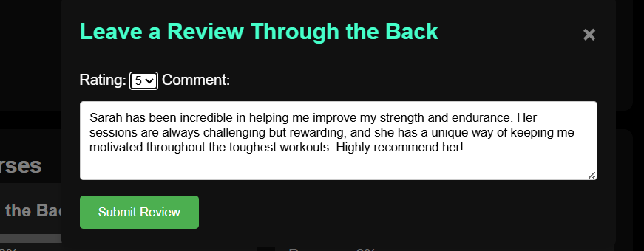
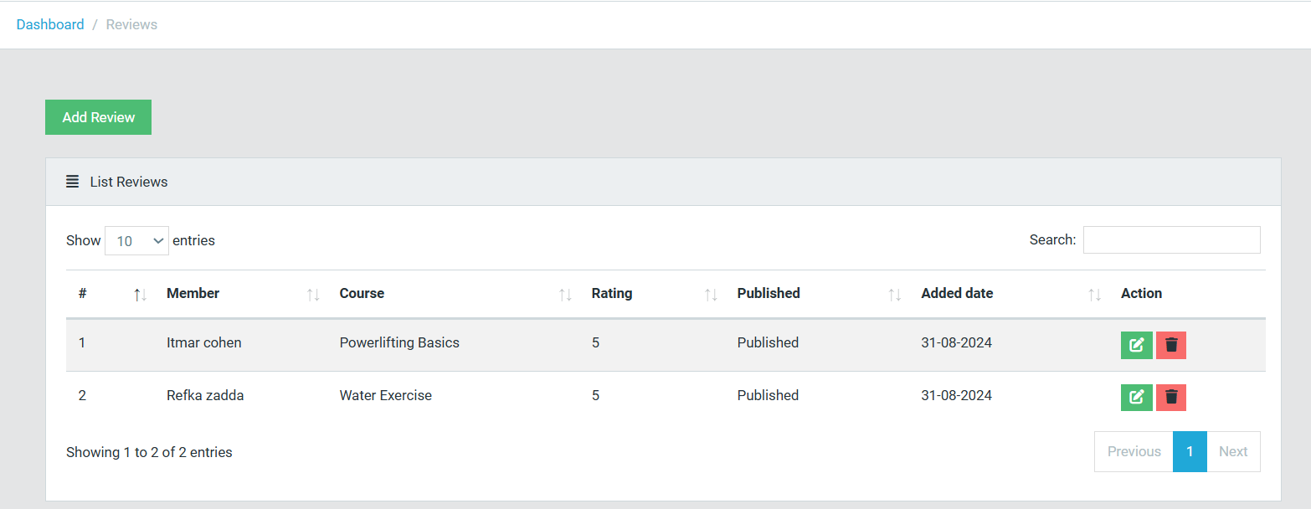
Client Reviews
15

Slide 16
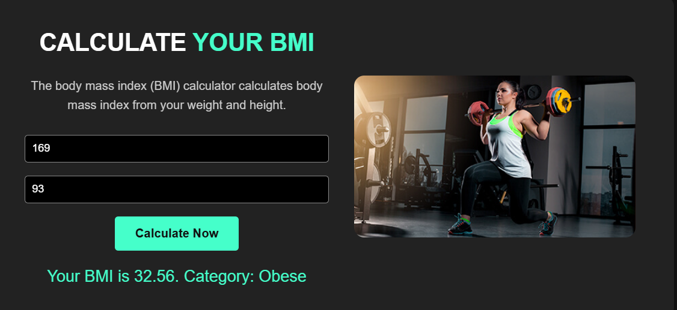
BMI Calculator
16

Slide 17
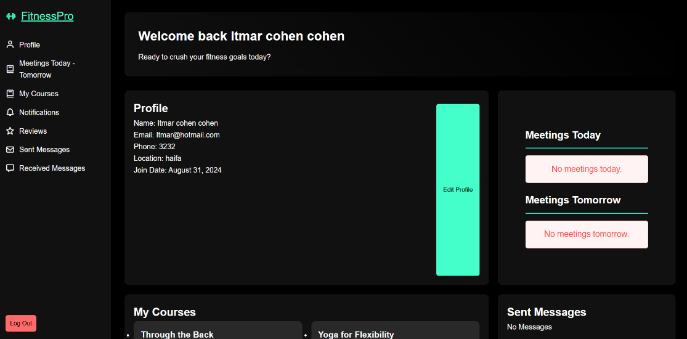
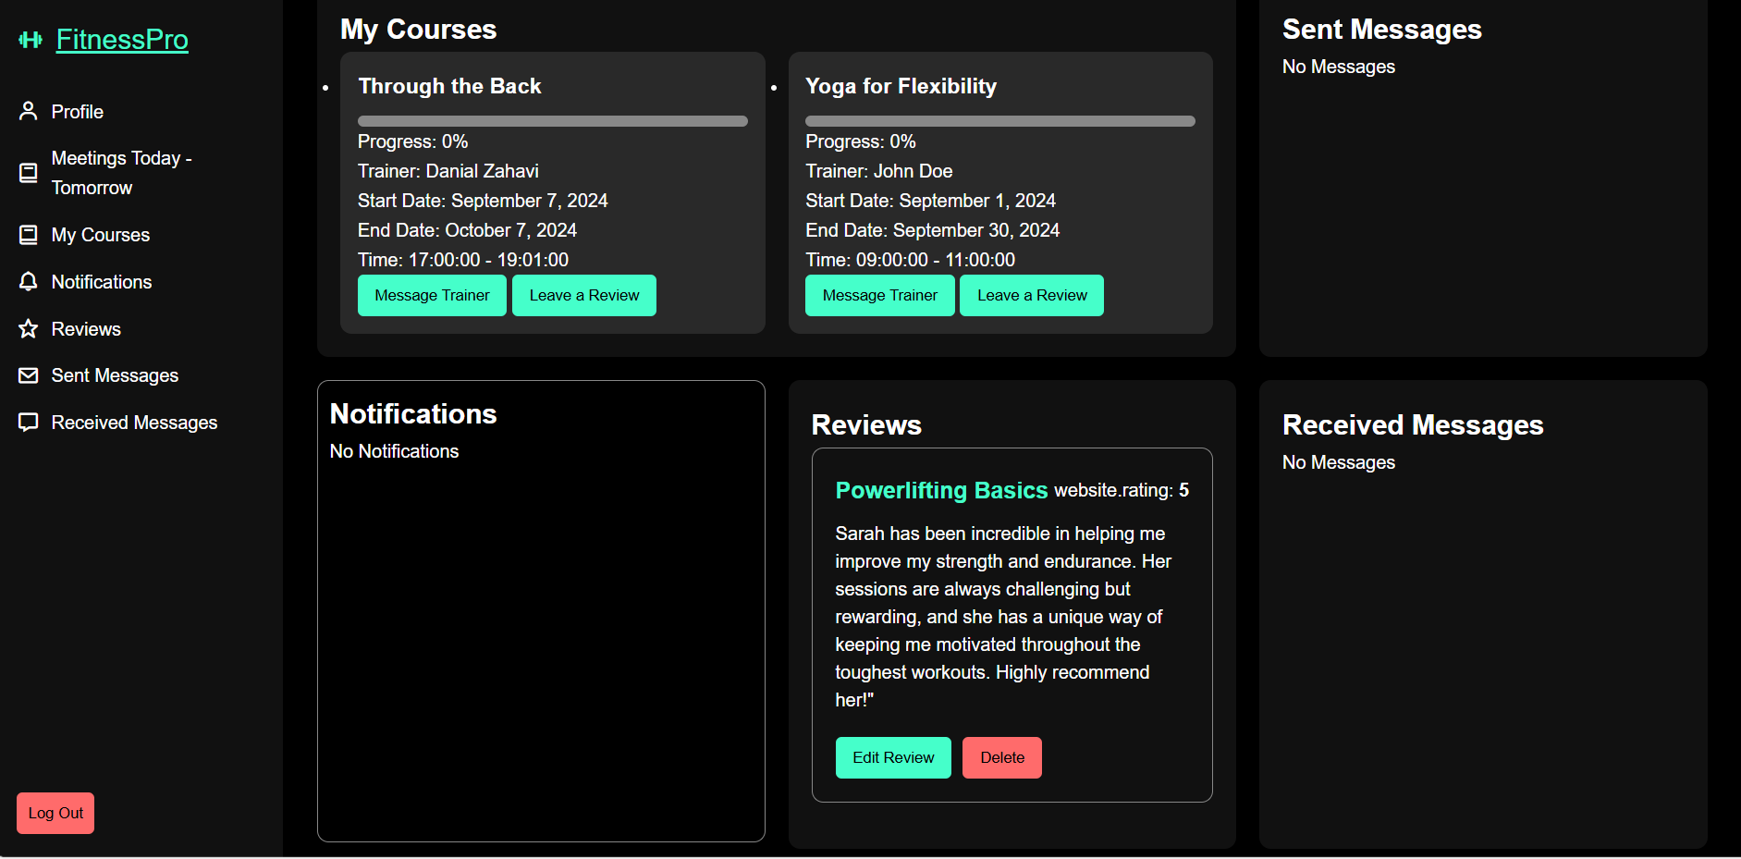
Member Experience
17

Slide 18
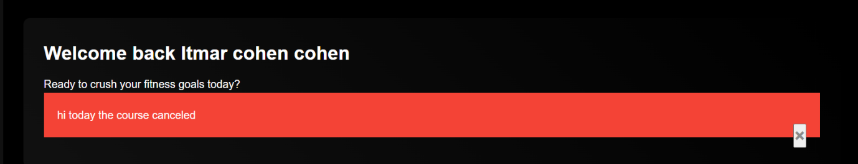
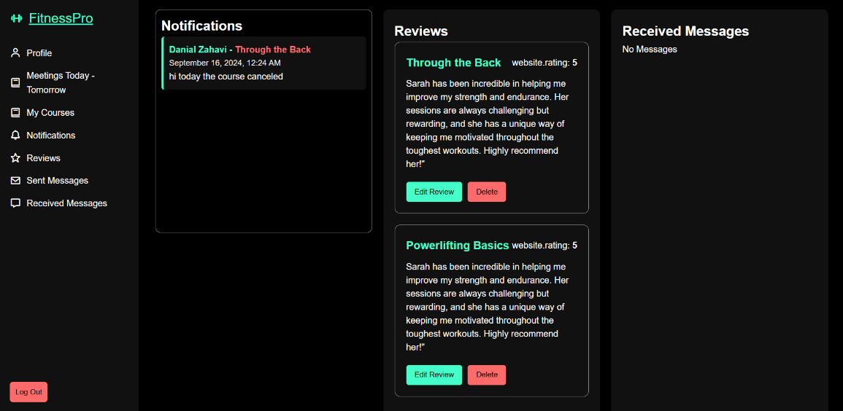
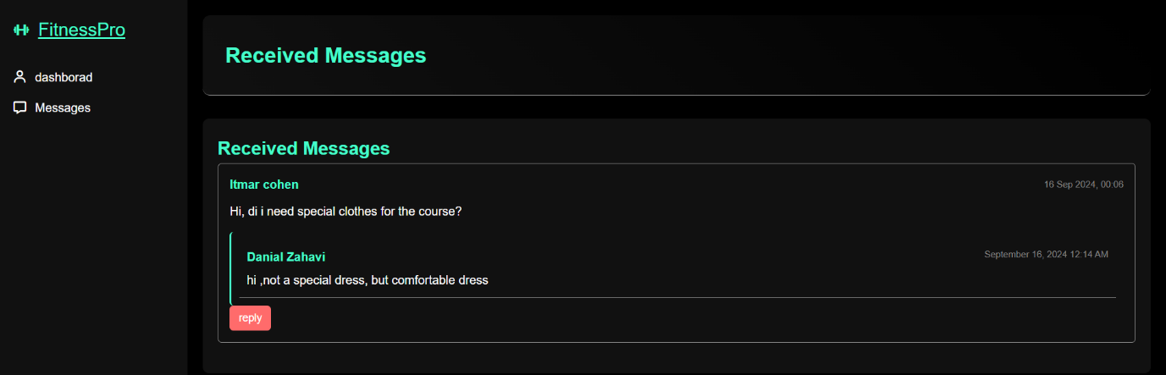
Member Experience
18

Slide 19
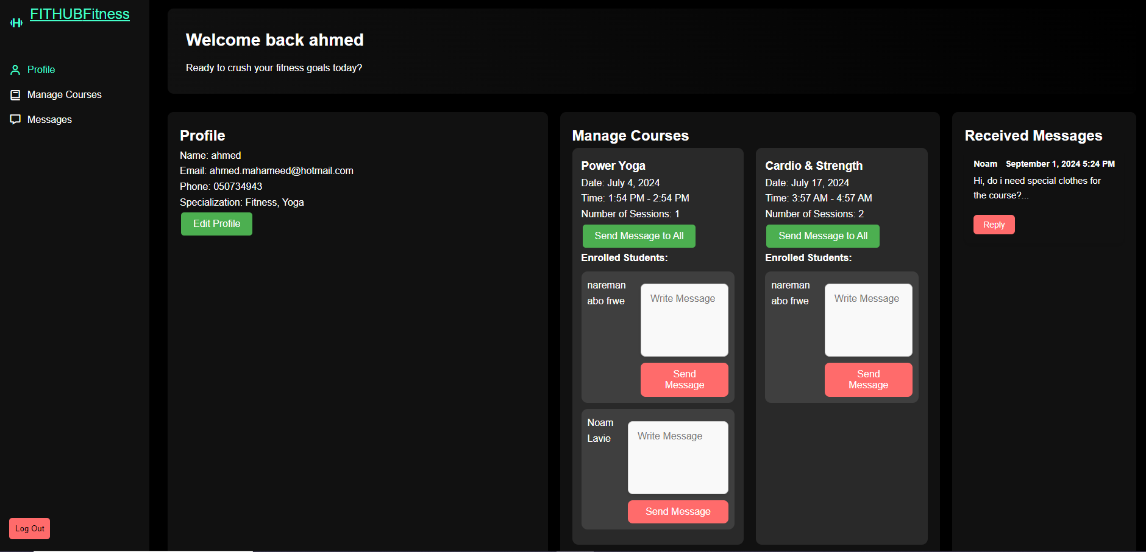
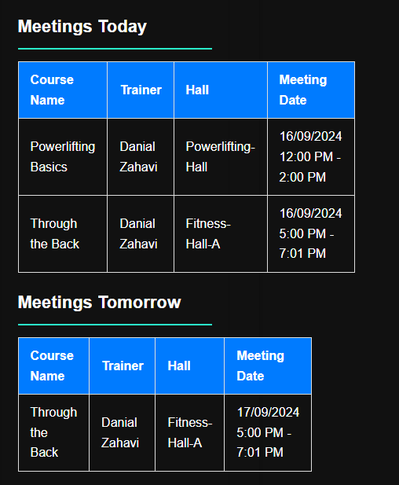
Instructor Experience
19

Slide 20
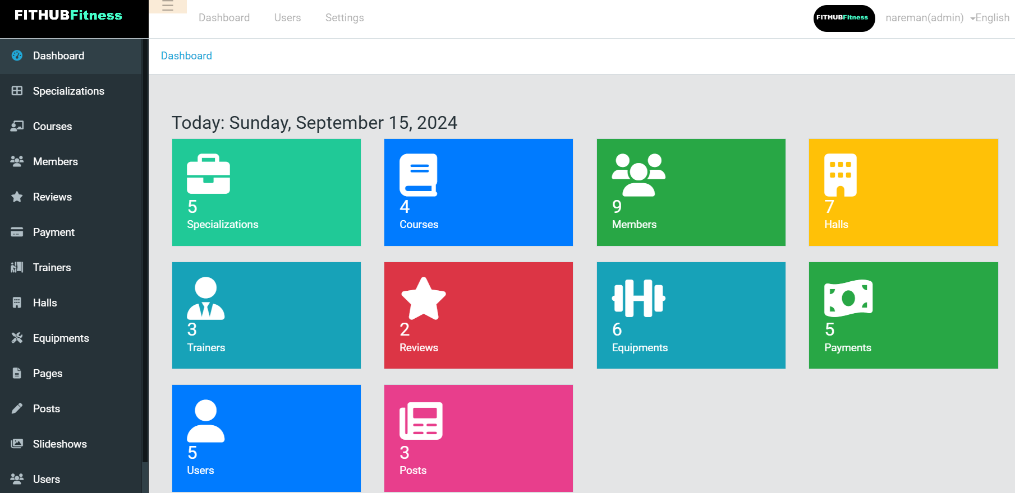
Admin Dashboard
Admin Experience
Admin Dashboard
20

Slide 21
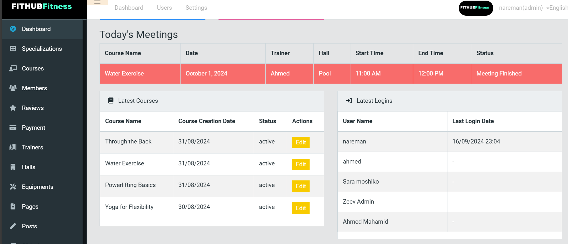
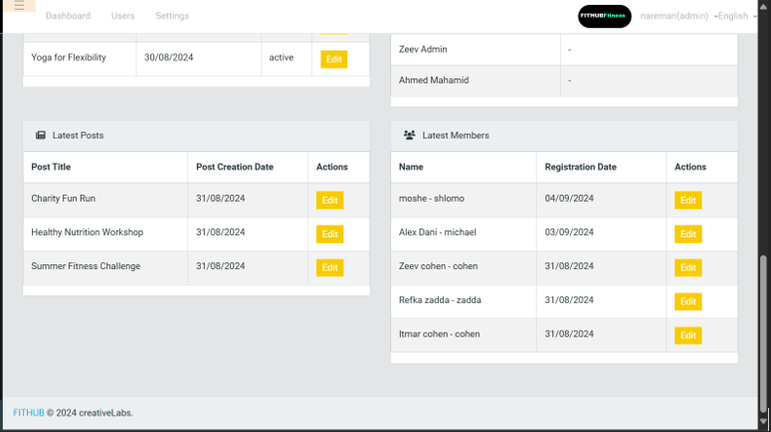
Admin Dashboard
Admin Dashboard
21

Slide 22
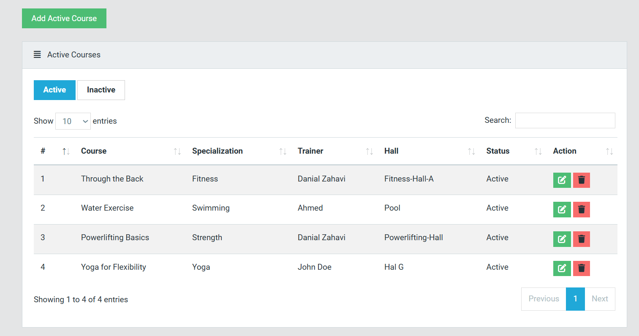
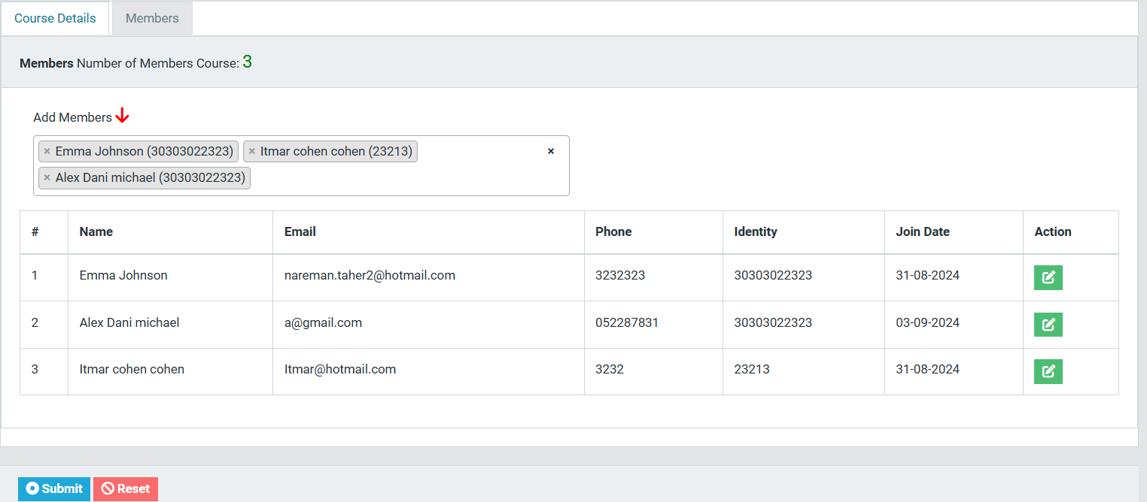
Admin Dashboard
Courses
22

Slide 23
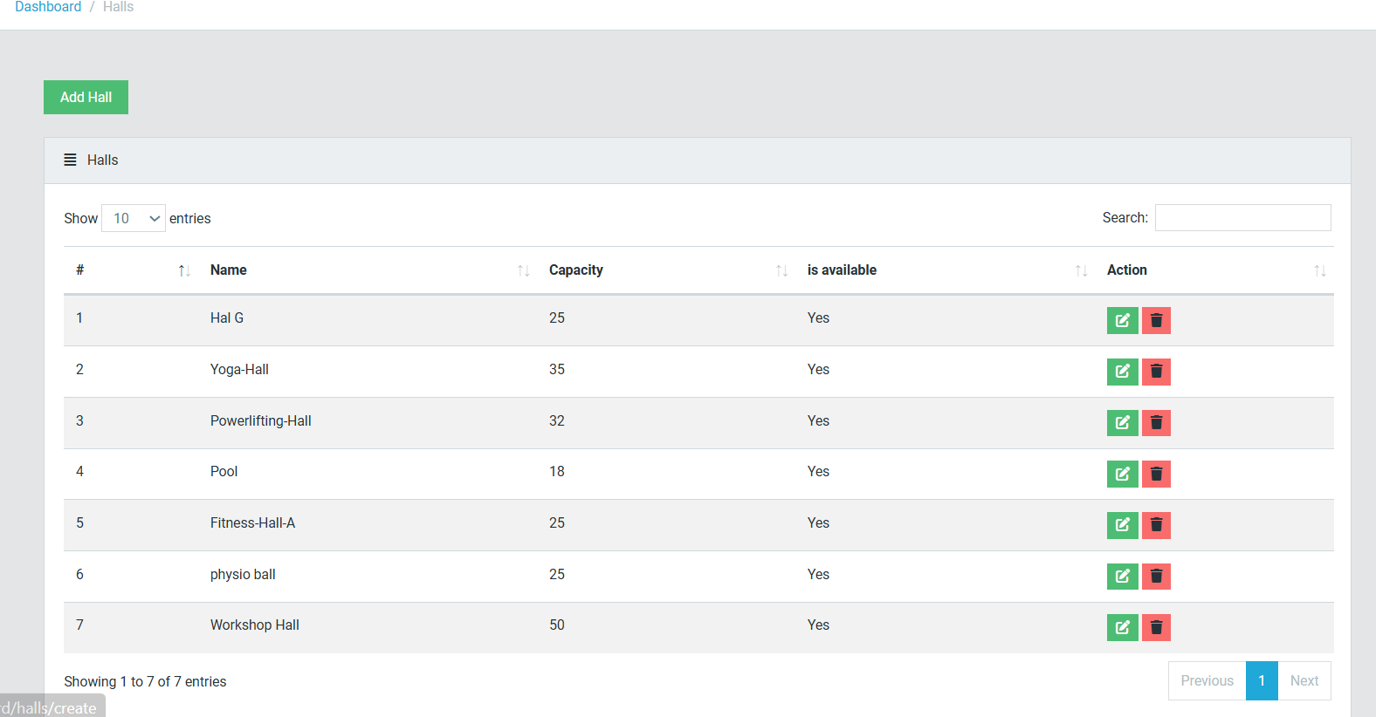
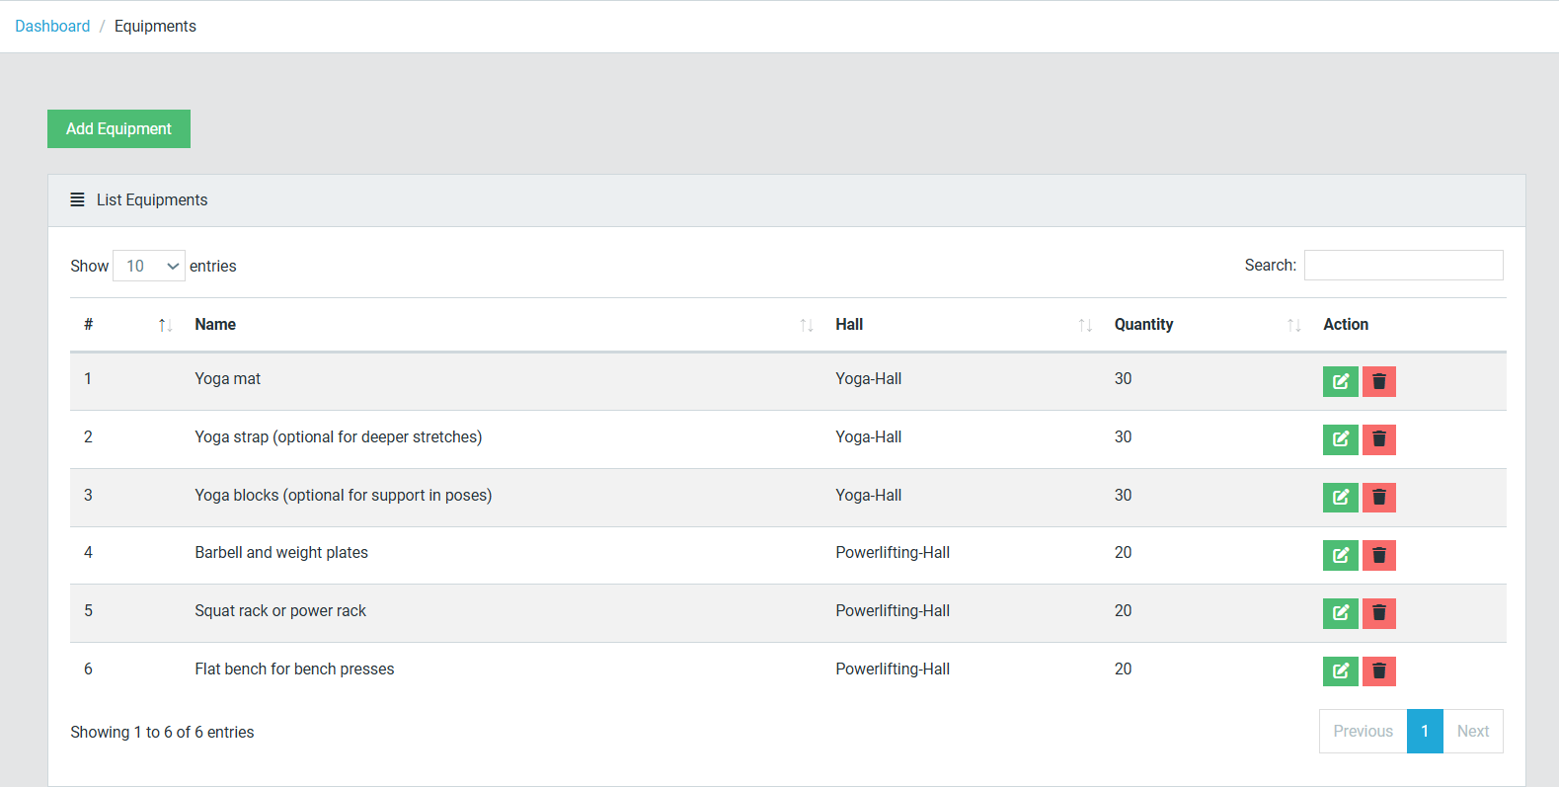
Admin Dashboard
Halls
Equipment
23

Slide 24
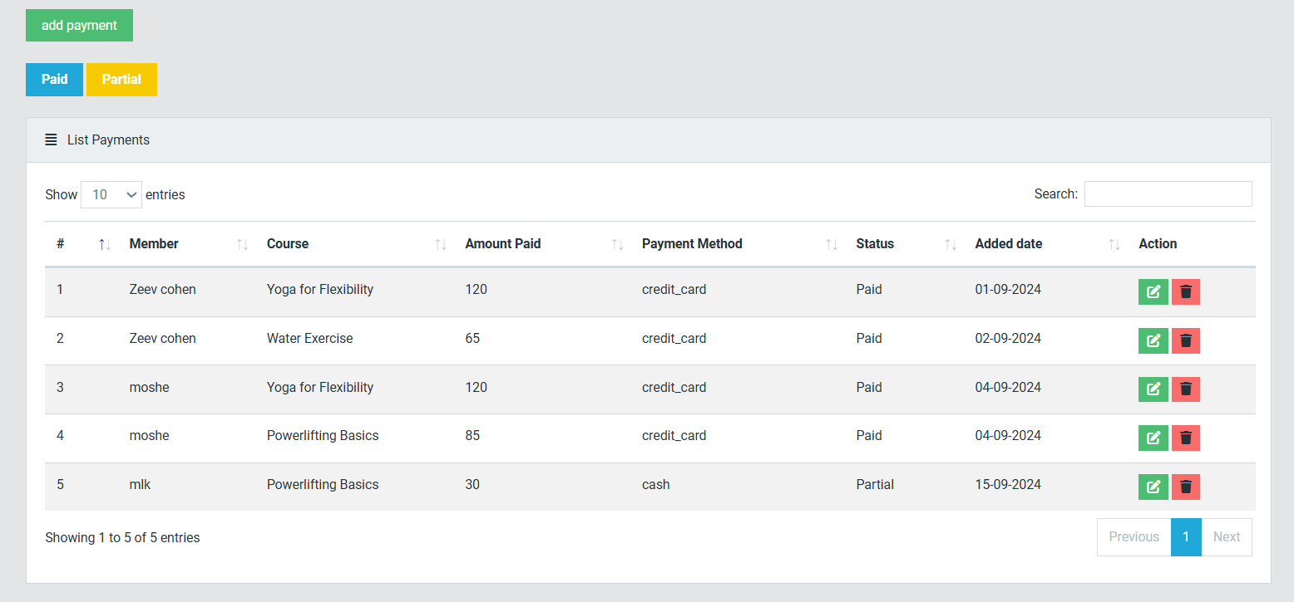
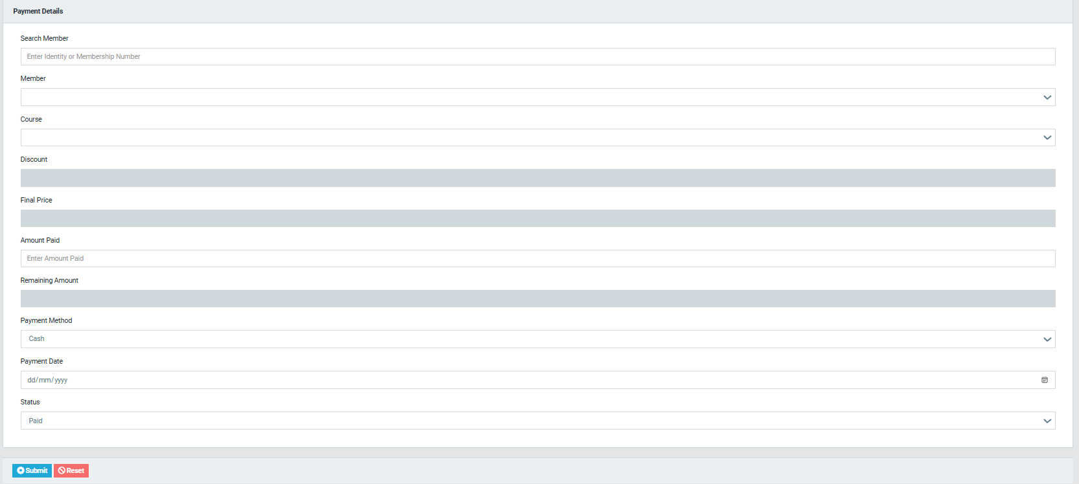
Admin Dashboard
Payment
24

Slide 25
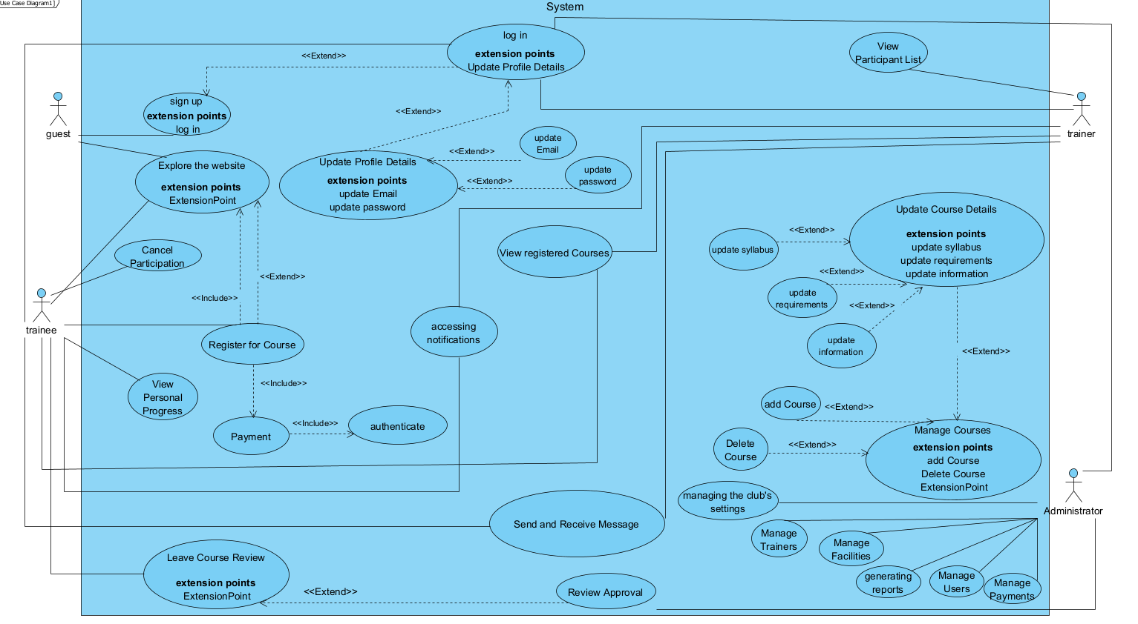
PRODUCT
USE CASE DIAGRAM
25

Slide 26
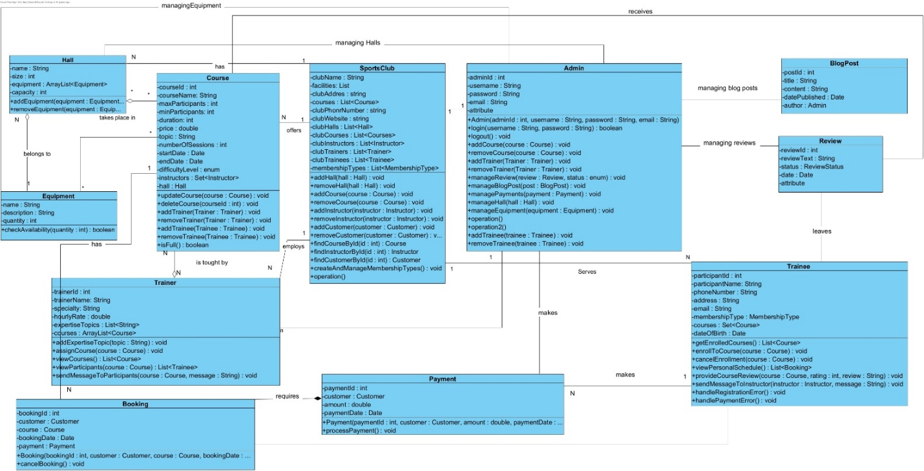
PRODUCT
CLASS DIAGRAM
26

Slide 27
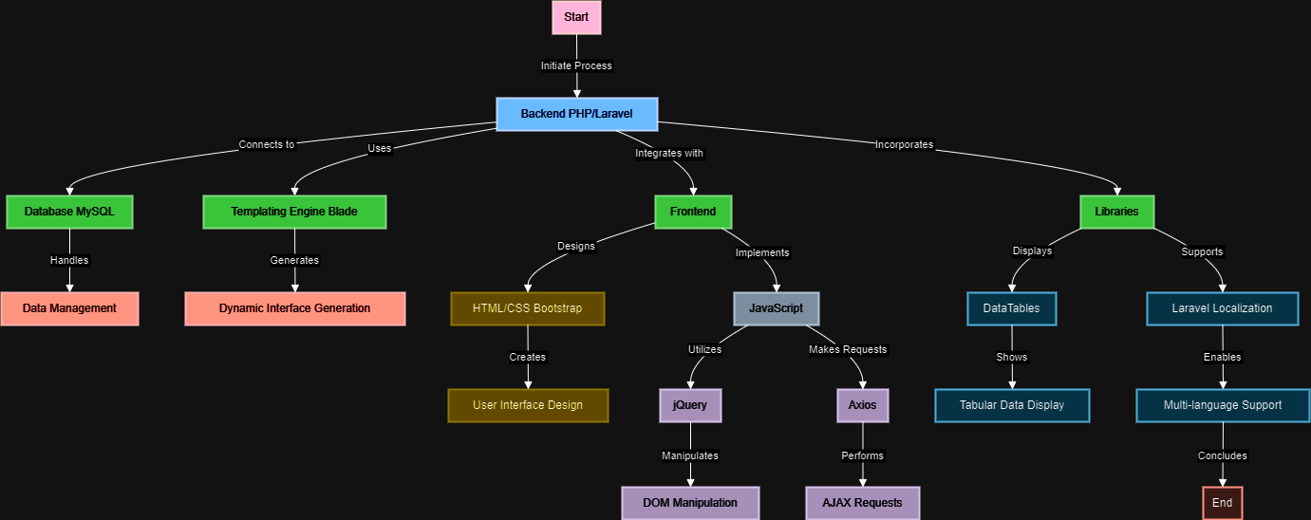
PRODUCT
Flowchart
27

Slide 28
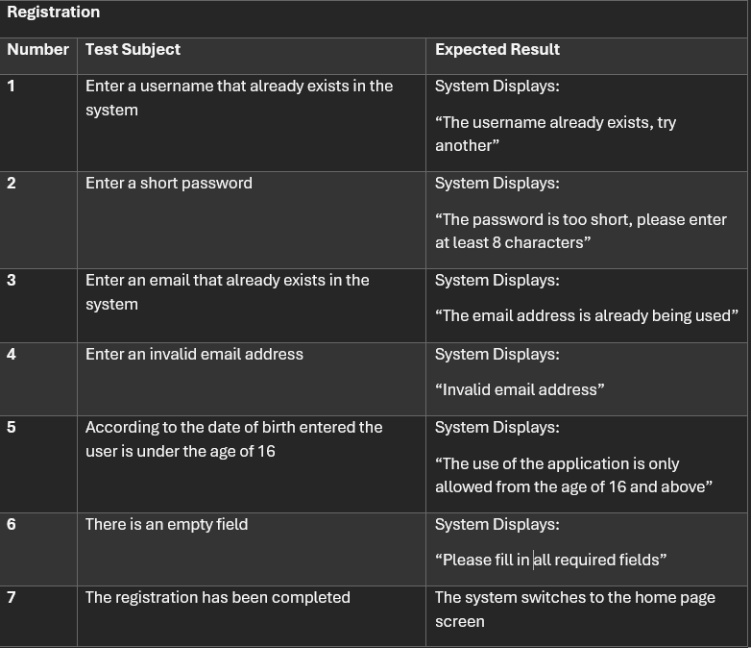
Testing
Registration
28

Slide 29
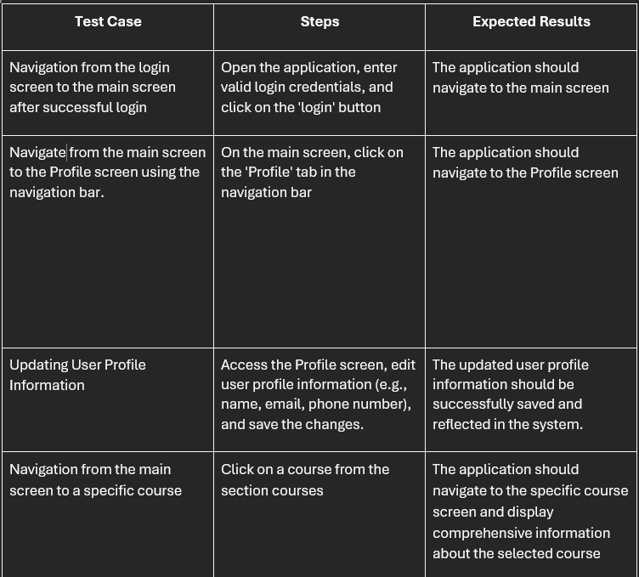
VERIFICATION-TESTING
Manual testing
29

Slide 30
PROCESS CHALLENGES
Requirement Gathering and Analysis.
Planning the System.
Working Alone.
Testing.
30

Slide 31
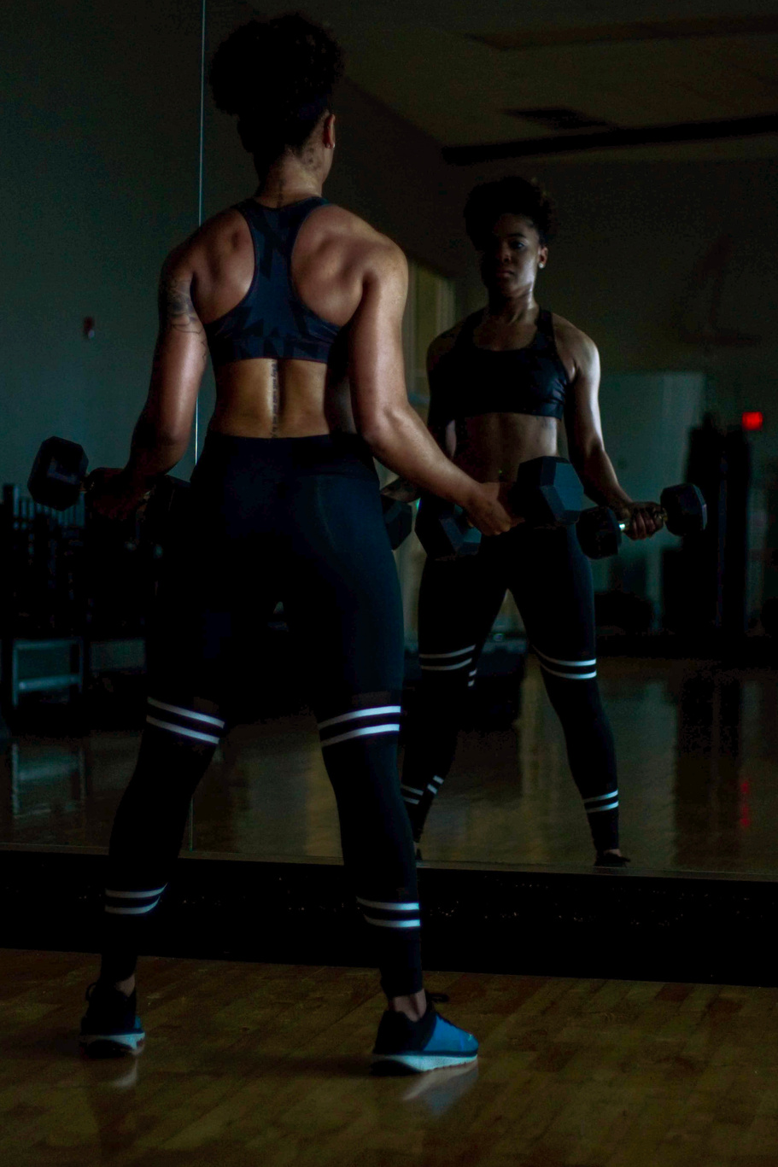
THANK YOU
"Empower your sports club with our innovative management system—where efficiency meets excellence."
SETTING YOU UP FOR SUCCESS
31

